Slide 1
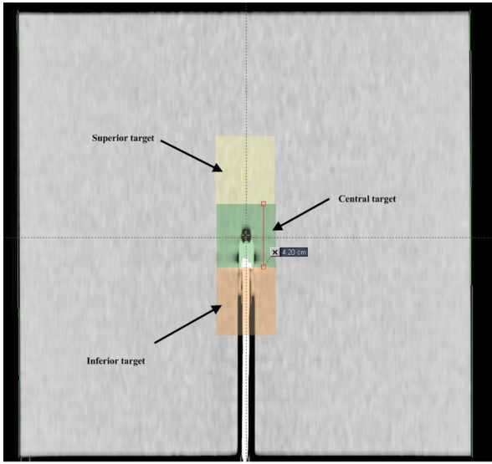
What is the image on the left depicting?
What other configurations do you think would be tested as part of this QA?
What phantom(s) would you use?
What dosimeter(s) would you use?
What are some limitations of this testing?

Slide 2
What is superposition convolution? Give an example of an algorithm that uses it and describe how it is applied.
How is Acuros XB different?
In what situations do you think there is likely to be a potentially significant difference in results between Acuros XB and the algorithm you described in the first part?
Qualitatively, what will that difference be?

Slide 3
How would you recommend a patient be simmed for treatment of bladder cancer?
What prescription dose do you expect?
What are some OARs you would be concerned about during planning and what constraints would you use?
How would you expect this patient to be aligned on the machine?
Your MD wants you to mathematically calculate some suggested margins for these types of cases. How would you go about doing that?

Slide 4
Draw a schematic of an MLC leaf and MLC bank.
Indicate the MLC model you have drawn, and describe in detail the design of the MLC.
What is the purpose of the rounded leaf end on some MLC models?
Describe the three types of MLC leakage and how these are accounted for in the treatment planning system.
Briefly describe the DLG and how it is measured.

Slide 5
Name several sites that are commonly treated with SBRT.
For one of these sites, describe how SBRT differs from standard IMRT in regards to:
Simulation
Prescription
Contouring
Treatment Planning
Physics checks
Treatment

Slide 6
Briefly describe Gamma analysis and its uses in IMRT QA.
What are recommended tolerance and action limits for gamma analysis, including related parameters?
Describe True Composite and Perpendicular field-by-field IMRT QA methods. Name a device used to measure each.
An SBRT plan fails institutional tolerances for IMRT QA when delivered to the ArcCheck. How do you proceed?

